Slide 1
Cybersecurity for Future Presidents

Slide 2
Any Questions?

Slide 3
Cybersecurity events from the past week of interest to future (or current) Presidents:

Slide 4
Why do we have computers?

Slide 5
Technologies used in computing

Slide 6
Moore’s “Law”

Slide 7
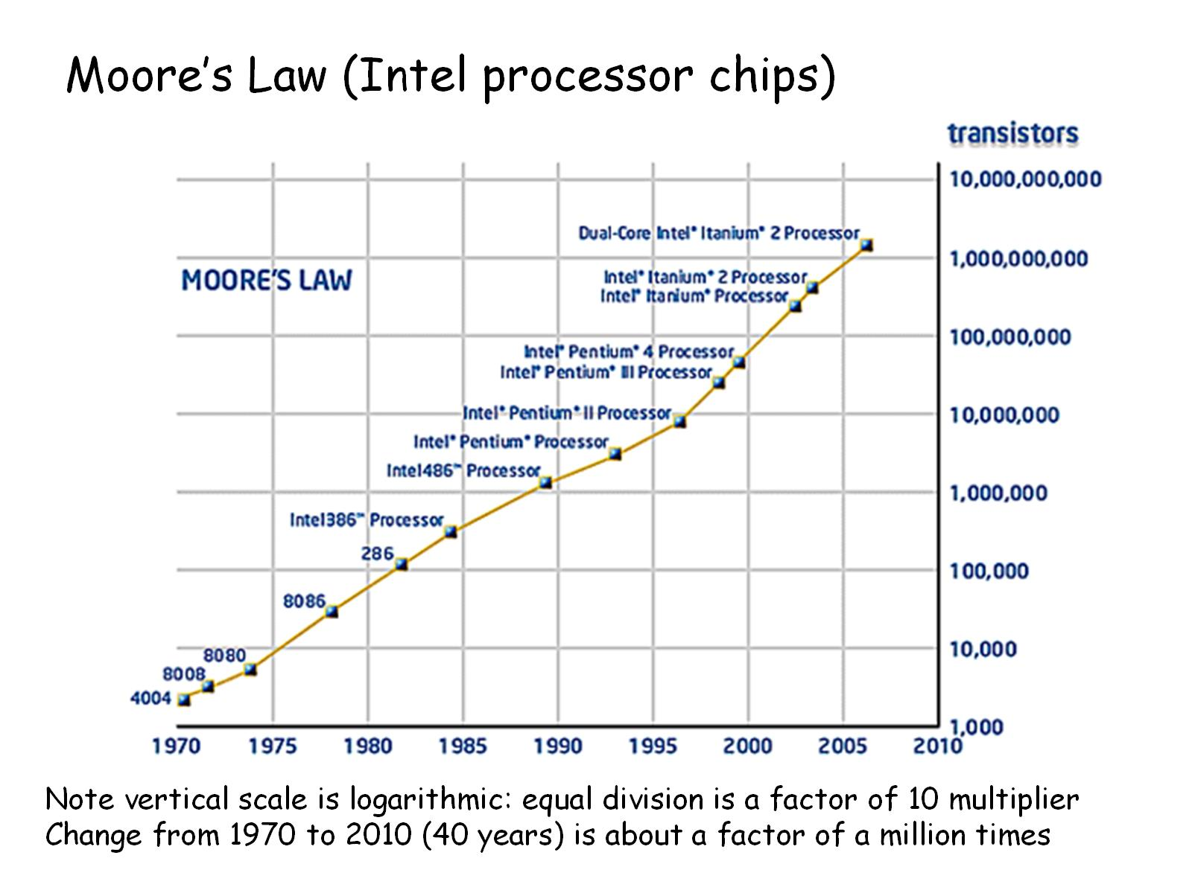
Moore’s Law (Intel processor chips)

Slide 8
Moore’s Law in action over 40 years

Slide 9
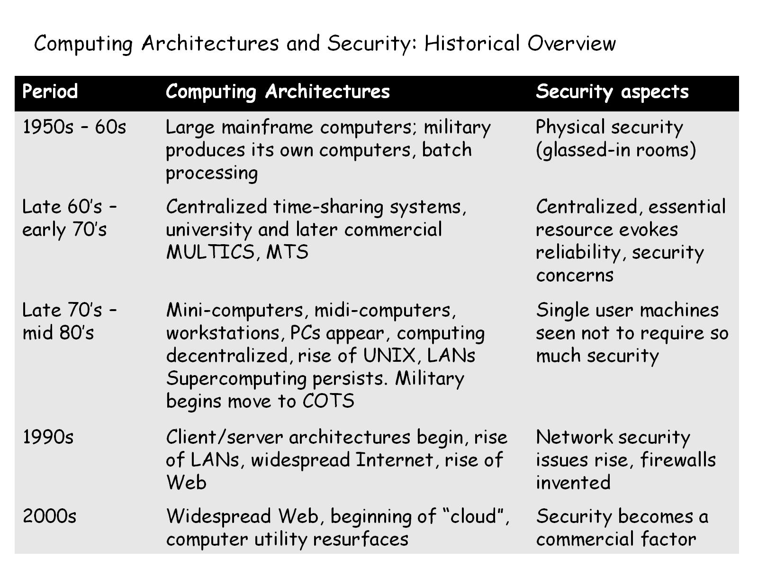
Computing Architectures and Security: Historical Overview

Slide 10
Desired System Properties

Slide 11
Security Function and Security Assurance

Slide 12
Cybersecurity Economics

Slide 13
Business computing security vs. military

Slide 14
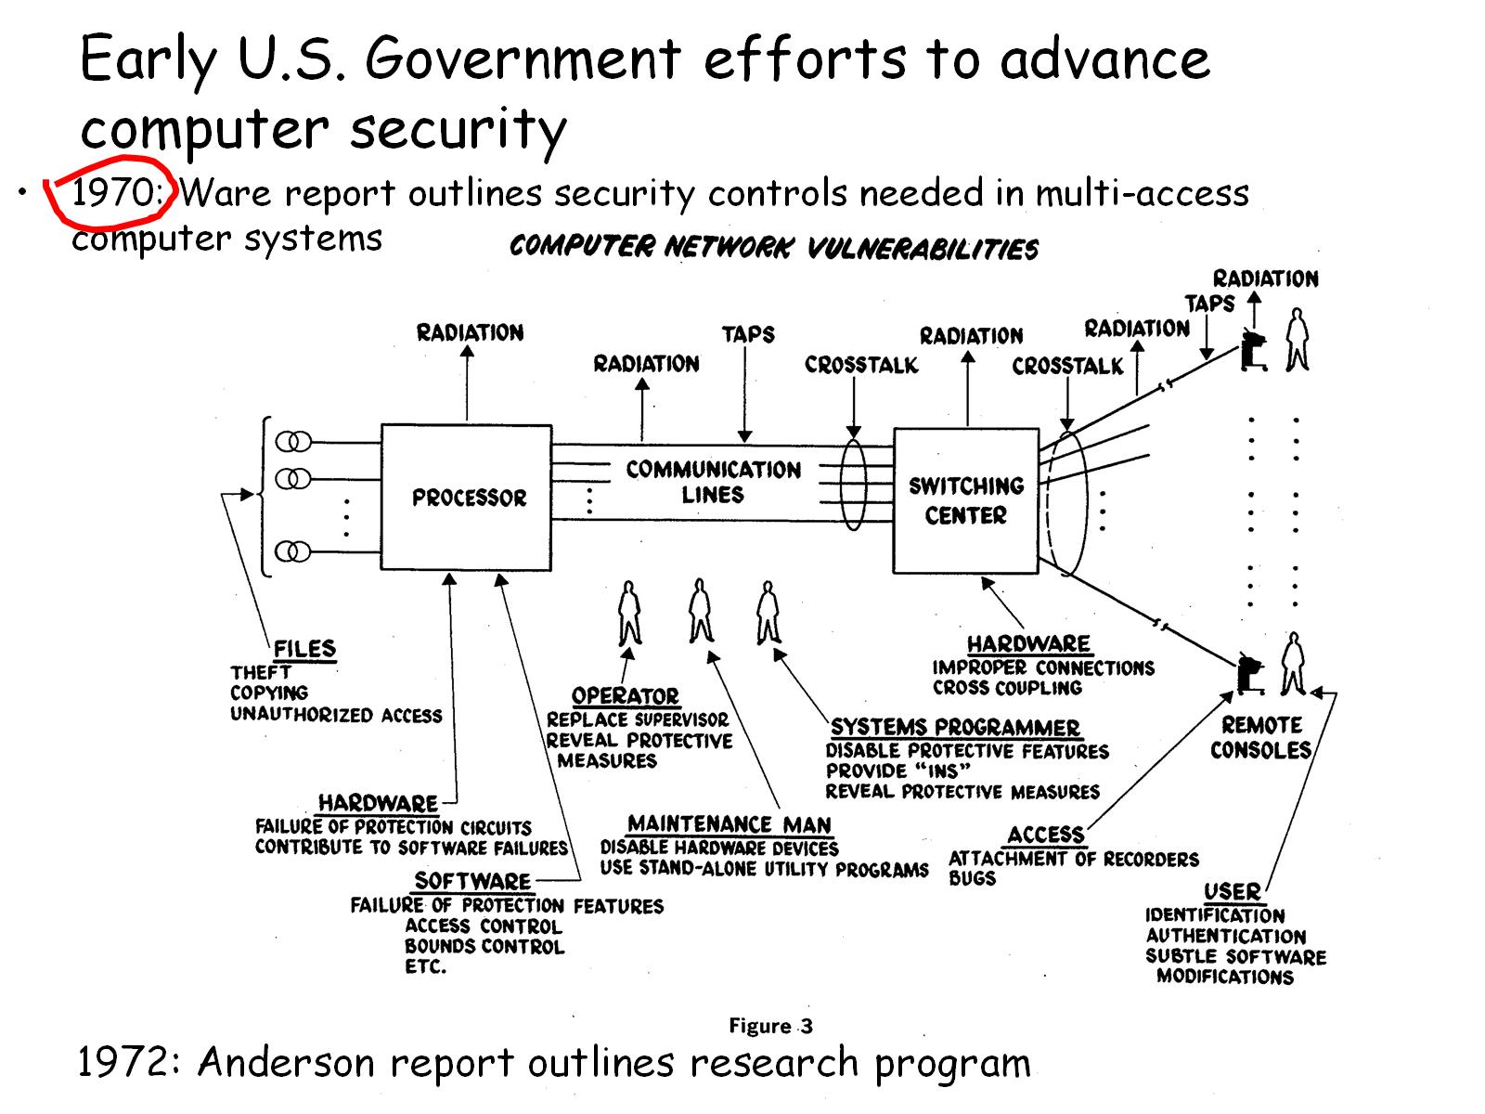
Early U.S. Government efforts to advance computer security

Slide 15
Late 1970s – early 1980s: DoD Computer Security Evaluation Scheme: Confluence of Security, Technology, Economics

Slide 16
Operating System Security R&D and Criteria Development 1968 - 2000

Slide 17
How this approach (TCSEC+) has worked in practice

Slide 18
Problem for future Presidents

Slide 19
And now for something completely different…

Slide 20
Genetics / Genomics primer

Slide 21
How much do human genomes vary?

Slide 22
Cost to sequence a person’s genome

Slide 23
What makes DNA/Genomic data special?

Slide 24
Potential benefits from use of genetic/genomic data

Slide 25
Potential abuses of genetic/genomic data

Slide 26
What laws protect genetic / genomic data?

Slide 27
How might genetic/genomic data be useful yet technologically protected?

Slide 28
Recap

Slide 29
Abacus – base 10

Slide 30
Pascal’s Calculator (the Pascaline)

Slide 31
Slide Rule (based on logarithms)

Slide 32
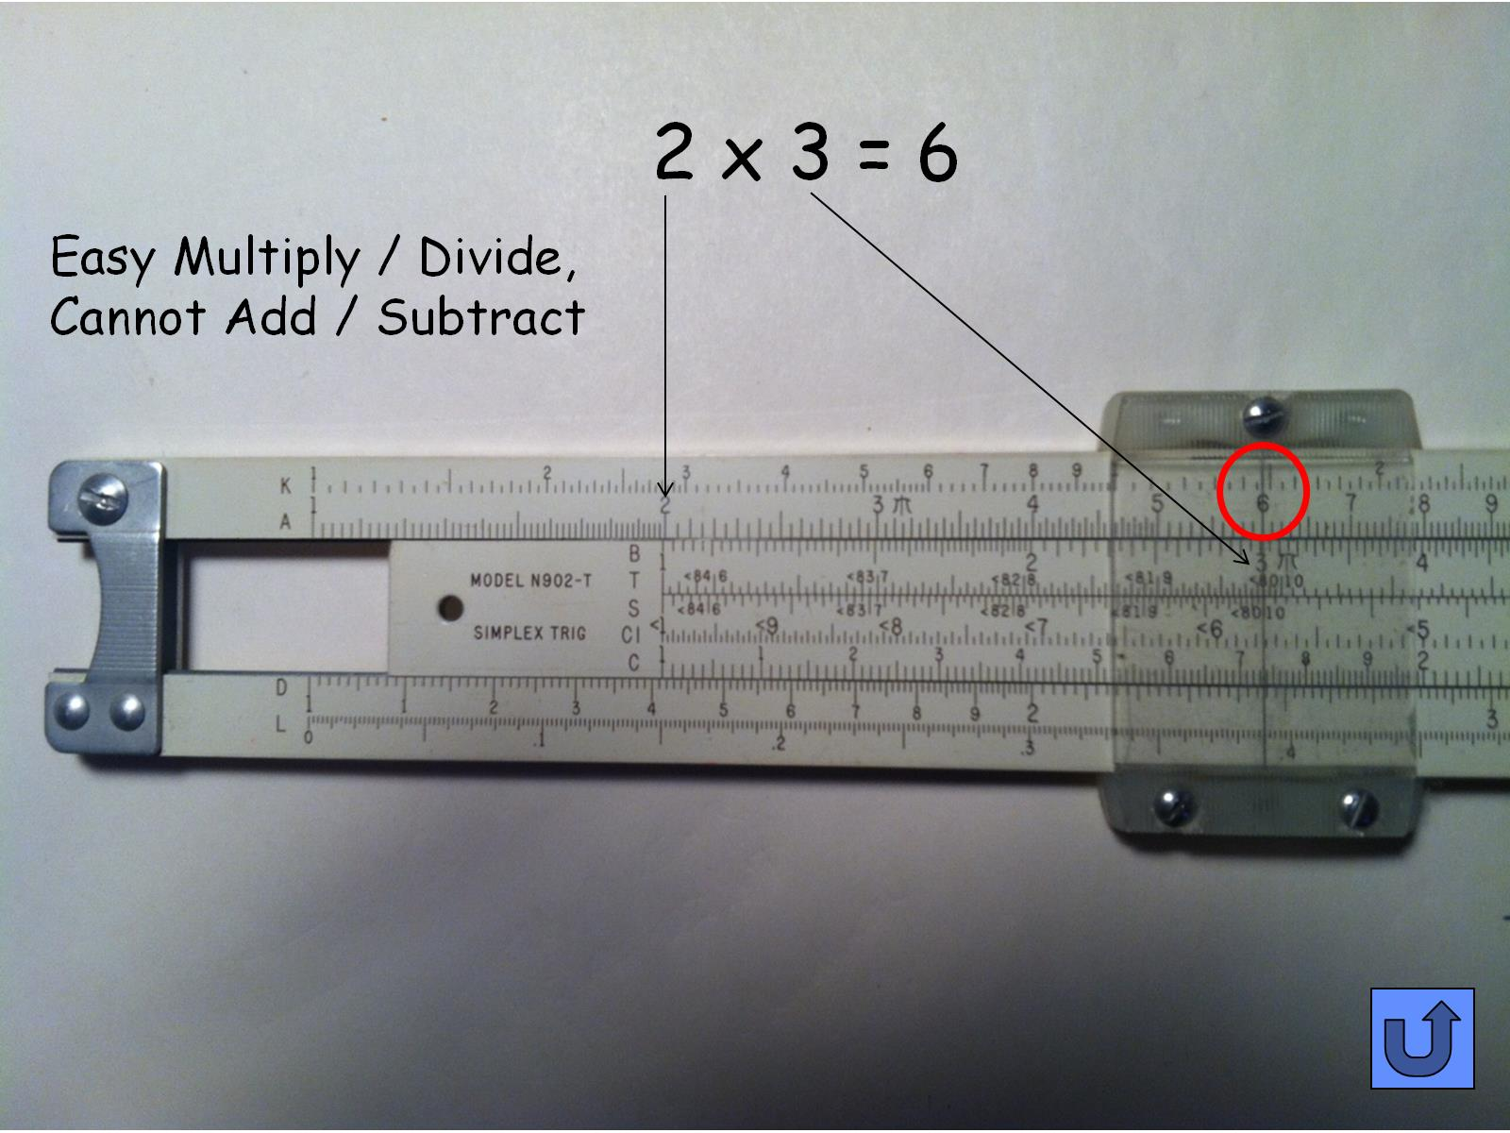
2 x 3 = 6

Slide 33
Jacquard Loom, 1804

Slide 34
Babbage

Slide 35
Difference Engine in operation (March 1, 2012, Computer History Museum)

Slide 36
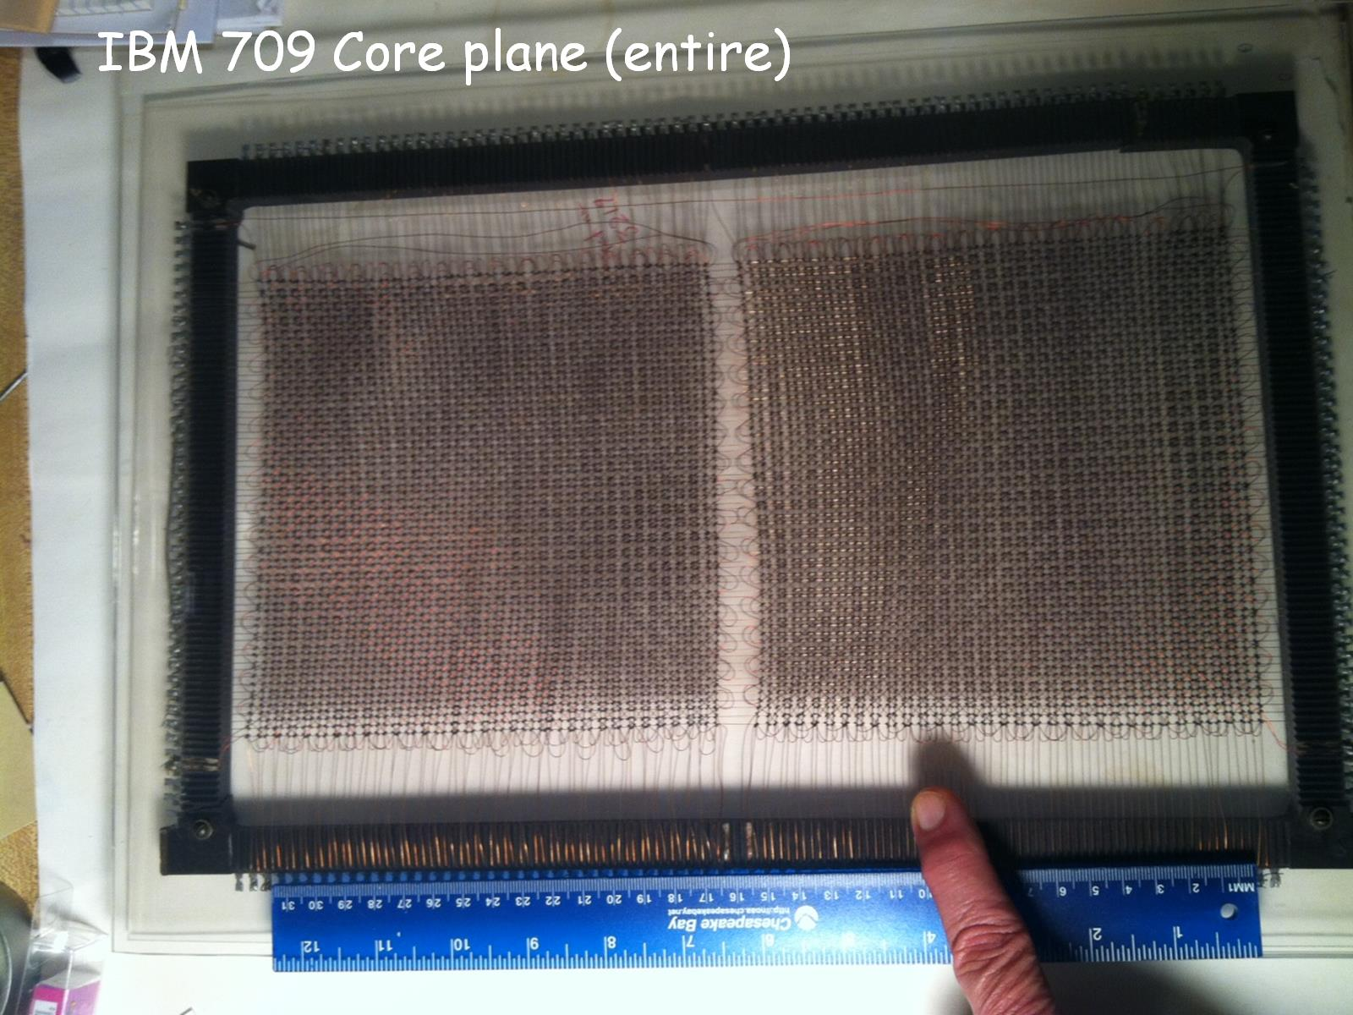
IBM 709 Core plane (entire)

Slide 37
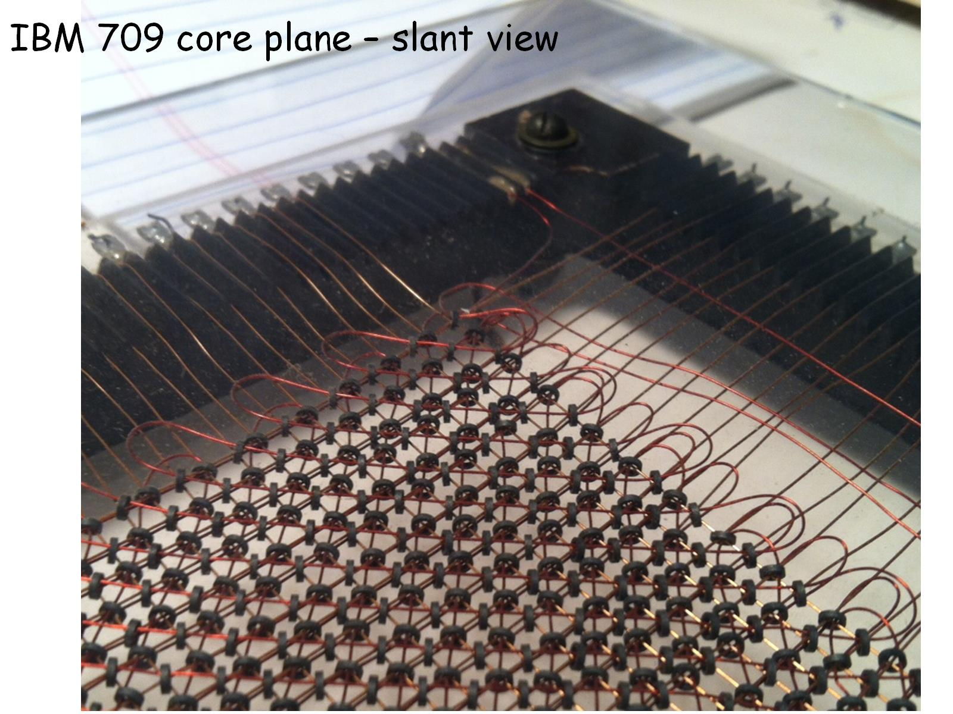
IBM 709 core plane – slant view

Slide 38
IBM 709 Core plane segment, early 1960s

Slide 39
Evolution of technology in modern digital computers (1)

Slide 40
Evolution of technologies in modern digital computers (2)

Slide 41
(Very!) Brief introduction to HIPAA

